Slide 1
Math Review for Matter and Atomic Theory
Get reference tables, white paper,
and calculators now. (hurry)

Slide 2
Isotopes are chemically identical atoms, with different numbers of neutrons.
They exist, but for no apparent reason. They just are.
All atoms are isotopes, some are the “most common isotopes” of that element.
Any isotope can be in the ground state, or excited state.
Each atom in high school has a whole number mass, we round to the nearest whole number – BUT, there are decimal masses on the periodic table, these are due to the proportions of each isotope.
The masses are not averages, they are weighted averages.

Slide 3
In these boxes is data for 3 naturally occurring isotopes
of the element “Ao”. Listed are their masses and the
relative proportions of each found in nature. What is the
average weighted atomic mass of this (fake) element Ao?
Isotope | Mass | Proportion
Ao-53 | 53.42 amu | 71.33%
Ao-54 | 54.12 amu | 16.93%
Ao-56 | 56.04 amu | 11.74%

Slide 4
In these boxes is data for 3 naturally occurring isotopes of the element “Ao”. Listed are their masses and their relative proportions found in nature. What is the average weighted atomic mass of this (fake) element Ao?
Isotope | Mass | Proportion
Ao-53 | 53.42 amu | 71.33%
Ao-54 | 54.12 amu | 16.93%
Ao-56 | 56.04 amu | 11.74%
This is the symbol “name” and approximate atomic mass of each isotope | These are the REAL MASSES you are supposed to use in the math. | These proportions need to be turned into decimals. Total 100% or 1.000!!!

Slide 5
In these boxes is data for 3 naturally occurring isotopes
of the element “Ao”. Listed are their masses and the
relative proportions of each found in nature. What is the
average weighted atomic mass of this (fake) element Ao?
Isotope | Mass | Proportion
Ao-53 | 53.42 amu | 71.33%
Ao-54 | 54.12 amu | 16.93%
Ao-56 | 56.04 amu | 11.74%
Isotope | Mass | Proportion | Proportional mass (4 SF)
Ao-53 | (53.42 amu) | (.7133)
Ao-54 | (54.12 amu) | (.1693)
Ao-56 | (56.04 amu) | (.1174)
Average weighted atomic mass =

Slide 6
In these boxes is data for 3 naturally occurring isotopes
of the element “Ao”. Listed are their masses and the
relative proportions of each found in nature. What is the
average weighted atomic mass of this (fake) element Ao?
Isotope | Mass | Proportion
Ao-53 | 53.42 amu | 71.33%
Ao-54 | 54.12 amu | 16.93%
Ao-56 | 56.04 amu | 11.74%
Isotope | Mass | Proportion | Proportional mass (4 SF)
Ao-53 | (53.42 amu) | (.7133) | 38.10 amu
Ao-54 | (54.12 amu) | (.1693)
Ao-56 | (56.04 amu) | (.1174)
Average weighted atomic mass =

Slide 7
In these boxes is data for 3 naturally occurring isotopes
of the element “Ao”. Listed are their masses and the
relative proportions of each found in nature. What is the
average weighted atomic mass of this (fake) element Ao?
Isotope | Mass | Proportion
Ao-53 | 53.42 amu | 71.33%
Ao-54 | 54.12 amu | 16.93%
Ao-56 | 56.04 amu | 11.74%
Isotope | Mass | Proportion | Proportional mass (4 SF)
Ao-53 | (53.42 amu) | (.7133) | 38.10 amu
Ao-54 | (54.12 amu) | (.1693) | 9.163 amu
Ao-56 | (56.04 amu) | (.1174)
Average weighted atomic mass =

Slide 8
In these boxes is data for 3 naturally occurring isotopes
of the element “Ao”. Listed are their masses and the
relative proportions of each found in nature. What is the
average weighted atomic mass of this (fake) element Ao?
Isotope | Mass | Proportion
Ao-53 | 53.42 amu | 71.33%
Ao-54 | 54.12 amu | 16.93%
Ao-56 | 56.04 amu | 11.74%
Isotope | Mass | Proportion | Proportional mass (4 SF)
Ao-53 | (53.42 amu) | (.7133) | 38.10 amu
Ao-54 | (54.12 amu) | (.1693) | 9.163 amu
Ao-56 | (56.04 amu) | (.1174) | 6.579 amu
Average weighted atomic mass =

Slide 9
In these boxes is data for 3 naturally occurring isotopes
of the element “Ao”. Listed are their masses and the
relative proportions of each found in nature. What is the
average weighted atomic mass of this (fake) element Ao?
Isotope | Mass | Proportion
Ao-53 | 53.42 amu | 71.33%
Ao-54 | 54.12 amu | 16.93%
Ao-56 | 56.04 amu | 11.74%
Isotope | Mass | Proportion | Proportional mass (4 SF)
Ao-53 | (53.42 amu) | (.7133) | 38.10 amu
Ao-54 | (54.12 amu) | (.1693) | 9.163 amu
Ao-56 | (56.04 amu) | (.1174) | 6.579 amu
Average weighted atomic mass = |  |  | 53.84 amu

Slide 10
Isotope | Mass | Proportion | Proportional mass (4 SF)
Ao-53 | (53.42 amu) | (.7133) | 38.10 amu
Ao-54 | (54.12 amu) | (.1693) | 9.163 amu
Ao-56 | (56.04 amu) | (.1174) | 6.579 amu
LOOK → → → |  | 1.000 | 53.84 amu
Isotope | Mass | Proportion
Ao-53 | 53.42 amu | 71.33%
Ao-54 | 54.12 amu | 16.93%
Ao-56 | 56.04 amu | 11.74%
LOOK → → → |  | 100%
PERFECT:::: sums up to 1.000 (1 whole) or 100%
ALWAYS check to make sure you are not making a dopey boo boo.

Slide 11
Five minutes of silence, everyone must get this correct.
Make believe element Ch (for chocolate chips!) data as follows. What is the average weighted atomic mass of these naturally occurring isotopes?
Isotope | Mass | Proportion
Ch-43 | 42.99 amu | 76.25%
Ch-44 | 44.15 amu | 12.84%
Ch-46 | 46.22 amu | 10.91%

Slide 12
Make believe element Ch data as follows.
What is the average weighted atomic mass
of these naturally occurring isotopes?
Isotope | Mass | Proportion
Ch-43 | 42.99 amu | 76.25%
Ch-44 | 44.15 amu | 12.84%
Ch-46 | 46.22 amu | 10.91%
Isotope | Mass | Proportion | Proportional mass (4 SF)
Ch-43 | (42.99 amu) | (.7625)
Ch-44 | (44.15 amu) | (.1284)
Ch-46 | (46.22 amu) | (.1091)
 |  | Sums to 1.000!
Average weighted atomic mass =

Slide 13
Make believe element Ch data as follows.
What is the average weighted atomic mass
of these naturally occurring isotopes?
Isotope | Mass | Proportion
Ch-43 | 42.99 amu | 76.25%
Ch-44 | 44.15 amu | 12.84%
Ch-46 | 46.22 amu | 10.91%
Isotope | Mass | Proportion | Proportional mass (4 SF)
Ch-43 | (42.99 amu) | (.7625) | 32.78 amu
Ch-44 | (44.15 amu) | (.1284)
Ch-46 | (46.22 amu) | (.1091)
Average weighted atomic mass =

Slide 14
Make believe element Ch data as follows.
What is the average weighted atomic mass
of these naturally occurring isotopes?
Isotope | Mass | Proportion
Ch-43 | 42.99 amu | 76.25%
Ch-44 | 44.15 amu | 12.84%
Ch-46 | 46.22 amu | 10.91%
Isotope | Mass | Proportion | Proportional mass (4 SF)
Ch-43 | (42.99 amu) | (.7625) | 32.78 amu
Ch-44 | (44.15 amu) | (.1284) | 5.669 amu
Ch-46 | (46.22 amu) | (.1091)
Average weighted atomic mass =

Slide 15
Make believe element Ch data as follows.
What is the average weighted atomic mass
of these naturally occurring isotopes?
Isotope | Mass | Proportion
Ch-43 | 42.99 amu | 76.25%
Ch-44 | 44.15 amu | 12.84%
Ch-46 | 46.22 amu | 10.91%
Isotope | Mass | Proportion | Proportional mass (4 SF)
Ch-43 | (42.99 amu) | (.7625) | 32.78 amu
Ch-44 | (44.15 amu) | (.1284) | 5.669 amu
Ch-46 | (46.22 amu) | (.1091) | 5.043 amu
Average weighted atomic mass =

Slide 16
Make believe element Ch data as follows.
What is the average weighted atomic mass
of these naturally occurring isotopes?
Isotope | Mass | Proportion
Ch-43 | 42.99 amu | 76.25%
Ch-44 | 44.15 amu | 12.84%
Ch-46 | 46.22 amu | 10.91%
Isotope | Mass | Proportion | Proportional mass (4 SF)
Ch-43 | (42.99 amu) | (.7625) | 32.78 amu
Ch-44 | (44.15 amu) | (.1284) | 5.669 amu
Ch-46 | (46.22 amu) | (.1091) | 5.043 amu
Average weighted atomic mass = |  |  | 43.49 amu

Slide 17
Ground State vs. Excited State for electrons
All electrons live in orbitals, or shells, or energy levels.
They are called the first, second, third, fourth shells (or orbitals)
As it turns out, they are sized too. First orbital/shell only holds UP TO 2 electrons.
The second can fit UP TO 8 electrons. Never more. NOT EVER
Third shell/orbital is odd. IT FILLS UP with 8 electrons too, or it might stretch out, changing shape and size, to FIT UP TO 18 electrons.
How can you keep track of this? Group 18 on the periodic table, the NOBLE GASES all have ONLY FULL ORBITALS – which is why they do not bond with other atoms. The Noble gases are He, Ne, Ar, Kr, Xn, and Rn only. (look now)

Slide 18
Ground State vs. Excited State for electrons
All electron orbitals/shells listed on the periodic table are in the GROUND STATE, which means lowest possible energy ─ NORMAL situation for atoms.
In high school we don’t know EXACTLY WHAT AN EXCITED STATE MIGHT BE, but we learn the idea. There are many “possible” excited states you might choose to show. Pick an easy one.
For example: Neon is in a 2-8 ground state (finger in box 10 now)
Possible excited states include: 2-7-1, 1-8-1, or even 2-6-2
Don’t get fancy, don’t get dancey, if you a gangsta - I don’t care. KISS is my band.

Slide 19
Ground State vs. Excited State for electrons
Ground state or Excited state, there is NO CHANGE in the number of electrons, just WHERE THEY ARE TEMPORARILY.
Na is 2-8-1 in ground state. An excited state CANNOT BE Na 2-8-2 ever.
To get excited an atom must absorb a certain amount of energy unique to that atom (or compound).
Each has a unique number of protons pulling inward on a unique number of electrons.
It takes A CERTAIN amount of energy, a QUANTUM of energy
(an exact quantity) to be absorbed to make this happen.

Slide 20
SPEED THINKING. You must write ABC or D for each question, then we will review. BE FAST
Which orbital has the most energy?
A. First orbital (n=1)
B. Second orbital (n=2)
C. Third orbital (n=3)
D. Fourth orbital (n=4)

Slide 21
2. An atom gets excited by
A. absorbing energy
B. releasing energy
C. producing energy
D. destroying energy

Slide 22
3. What is the electron configuration of
copper in the ground state?
A. 2-4
B. 2-8-15-2
C. 2-8-13-1
D. 2-8-18-1

Slide 23
4. What could be a possible excited state for copper?
A. 2-8-18-1
B. 2-7-17-1
C. 2-7-18-2
D. 2-8-18-2

Slide 24
5. In order for an electron to return to the ground state
from the excited state, it must…
A. absorb energy
B. release energy
C. produce energy
D. store energy

Slide 25
6. A line in a substance’s spectrograph is produced when
an electron
A. absorbs energy
B. releases energy
C. produces energy
D. stores energy

Slide 26
7. The amount of energy required to excite any electron
is called
A. a lot of energy
B. a little bit of energy
C. a quantum of energy
D. the electronic energy

Slide 27
1. Which orbital has the most energy? The one furthest from the nucleus, here that is D. Fourth orbital (n-4)
2. An atom gets excited by
A. absorbing energy. It often is electricity but could be heat or even radiation.
3. What is the ground state for copper? (look at box 29, duh!) D. 2-8-18-1 Put your finger in the box please.
4. What could be an excited state for copper?
A. 2-8-18-1 NO, this is ground state B. 2-7-17-1 NO, this has only 28 electrons, one’s missing
C. 2-7-18-2 YES D. 2-8-18-2 NO, this has 30 electrons. (count!)
5. In order for an electron to return to the ground state from the excited state, it must…
B. release energy we see this as the spectra, the ONE COLOR our eyes see. How cool!
6. A line in a substance’s spectrograph is produced when an electron
B. releases energy - when it creates the spectra.
7. The amount of energy required to excite any electron is called C. a quantum of energy

Slide 28
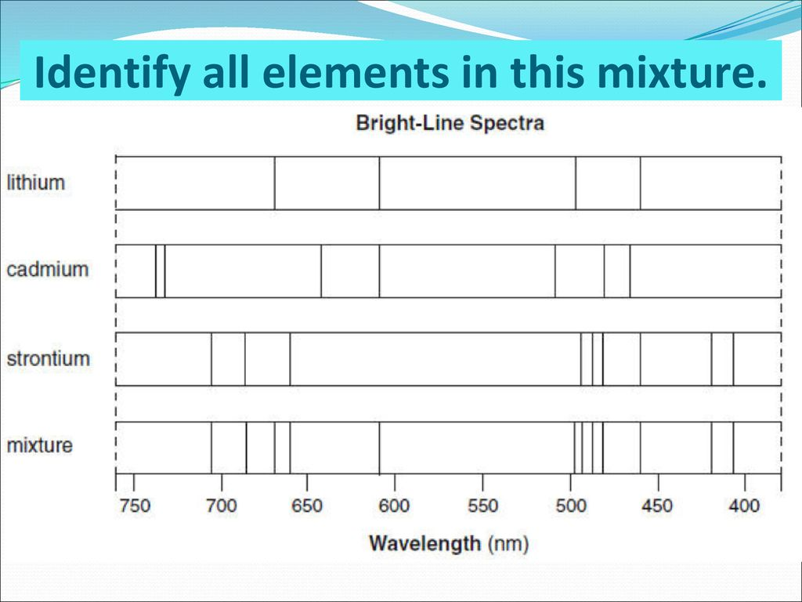

Slide 29
Most of cadmium’s lines are missing in the mixture.
All must be present for Cd to be IN THE MIXTURE.

Slide 30
Second Class Period Monday…
1. You will each make up (write out on paper) a multiple choice or word problem for Matter, and then for Atomic Theory, and put them in the inbox. They must have choices and an answer. Five points classwork each.
2. You can use the rest of the class period to check your grades, do work that you owe, or do the 3 atomic theory HW’s due by Thursday, or the Electrons Lab due by Thursday (all are “studying” for the celebration.

